Slide 1



Integrated Program in Business Analytics
HR ANALYTICS
Group E
Group Members
Rahim Kandanuru
Keerthana Thonupunuri
K Vaishnavi
Martin Joseph
M Prathyusha sai
Vidya Nand
Piyush Deepak Supekar

Slide 2
Agenda
Business Problem and Objectives
Executive Summary
Data Overview and Key Business Assumptions (if any)
Data Preparation and Pre-processing
Sanity checks, treatment and transformations for analytical dataset preparation
Exploratory Data Analysis
Key Business Findings and Insights
Model Development and Validations
Model comparisons on key scoring metrics and model finalization
Dashboarding (required only when it is in scope of analysis)
Businesss Recommendations and Potential Business Impact
Next Steps
Appendix

Slide 3



I. Business Problem and Objectives
The aim of the following project is to help HR department in predicting potential employees who are likely to be promoted.
To investigate and gain insight into the future of HR analytics if integrated into the company to assist managers in predictive decision – making based on statistical evidences and relevant HR analytical data.
To undertake an exploration of existing scenario with the aim of understanding the relationship between human resource and analytics and understand the role it plays in the improvement of the existing range of managerial and HR related ways.

Slide 4
II. Executive Summary
A typical HR analytics system collects employee data from HRIS (Human Resources Information system), business performance records and social media merges into Data Warehouse, statistical analysis and data mining techniques to provide understanding of hidden data patterns, relations, probabilities and forecasting.
HR Analytics is a relatively novel intervention in the larger domain of human resource management. It can be understood as being more credible because it provides statistically valid data and evidence that can be used in the process of creating new strategies and other measures.
The effective HR analytics will help the HR managers in performing HR functions such as forecasting the demand and supply of people, identifying suitable employments test to suit applicant profiles, creating list of employees to be promoted and managing employee discipline
This project contributes greatly to the HR Managers to make decisions based on data about the list of employees to be promoted based on number of trainings, previous year rating, length of service, KPIs met, awards, and average training score.

Slide 5
IV. Data Preparation and Pre-processing.
Train Dataset received had missing Values for the following columns :
For Previous_year_rating Column – Median of the data was used to impute the Data .
For education column - Multivariate feature imputation Algorithm⁽¹⁾ was used from the Scikit library.
This algorithm learns/trains from the other features where data is available and imputes data accordingly
Before Imputation
Column Name | Number of Missing Values
employee_id | 0
department | 0
region | 0
education | 2409
gender | 0
recruitment_channel | 0
no_of_trainings | 0
age | 0
previous_year_rating | 4124
length_of_service | 0
KPIs_met >80% | 0
awards_won? | 0
avg_training_score | 0
is_promoted | 0
After Imputation
Column Name | Number of Missing Values
employee_id | 0
department | 0
region | 0
education | 0
gender | 0
recruitment_channel | 0
no_of_trainings | 0
age | 0
previous_year_rating | 0
length_of_service | 0
KPIs_met >80% | 0
awards_won? | 0
avg_training_score | 0
is_promoted | 0
Imputation by
Multivariate Feature Imputation
Imputation by Median

Slide 6
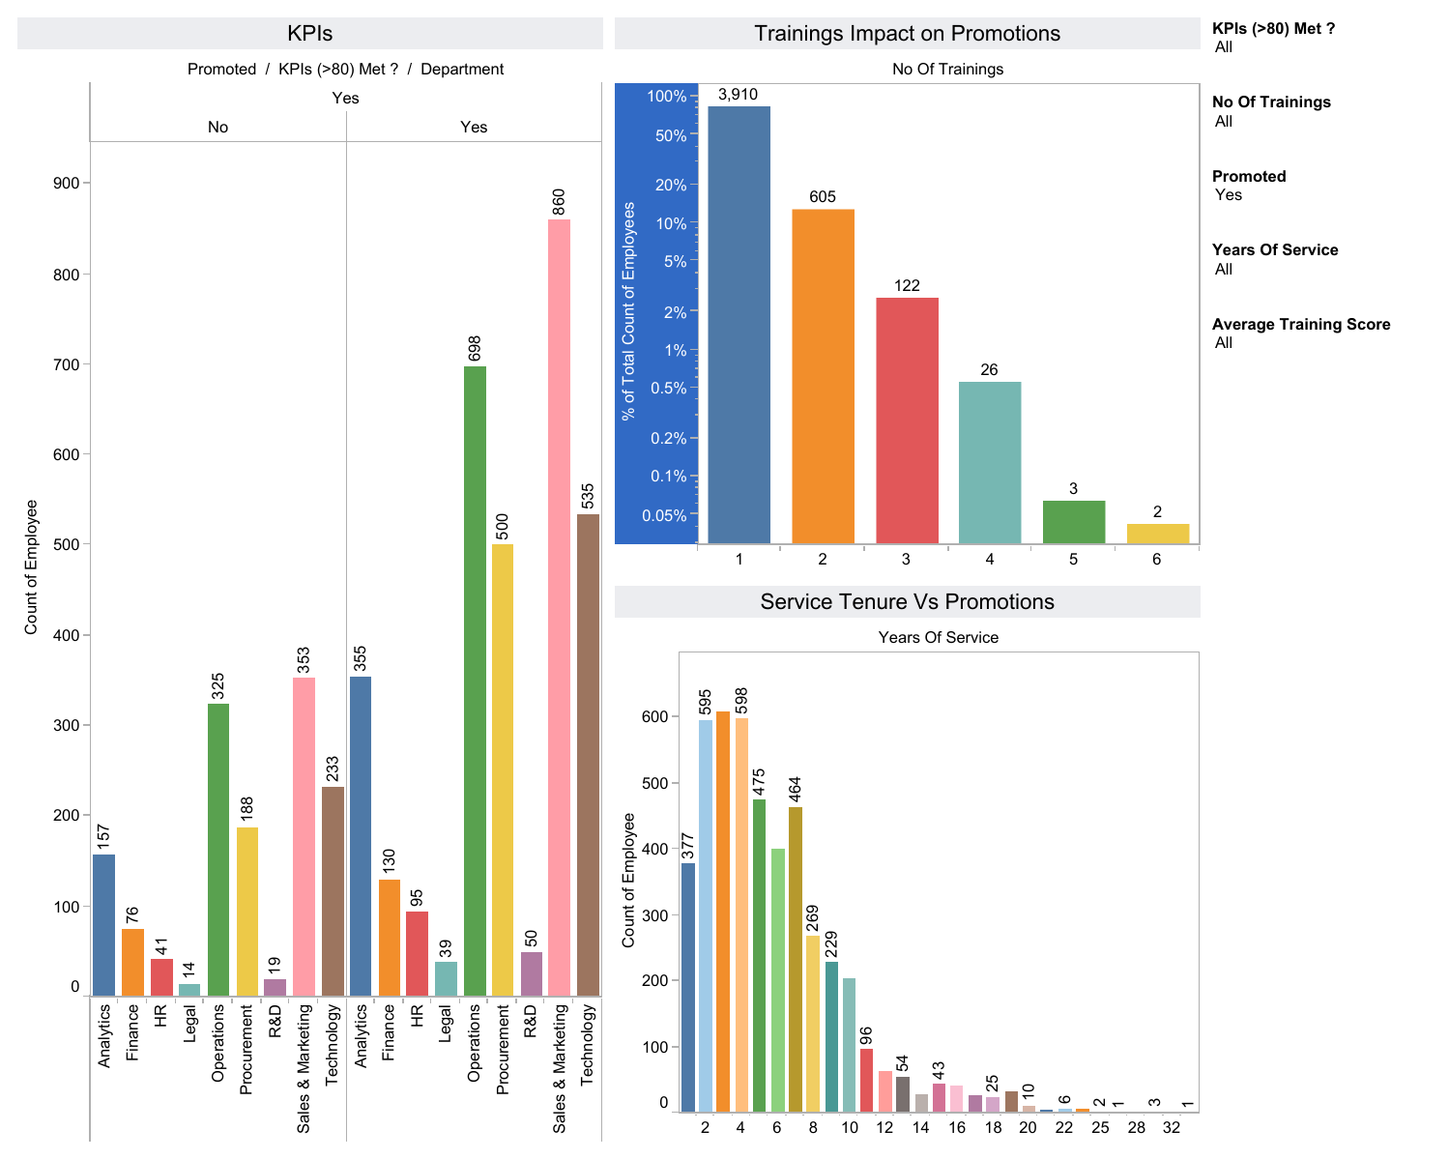
V. Exploratory Data Analysis- Tableau
Exploratory Analysis of Train Dataset was performed . Tableau Dashboard link is given below.
https://public.tableau.com/app/profile/rahim7106/viz/HRAnalysis_16419708932370/KPIsTrainingsPromotions?publish=yes

Slide 7
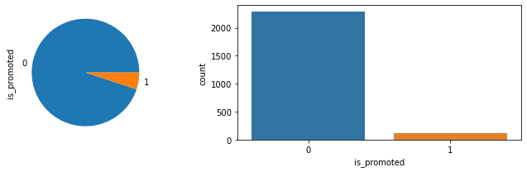
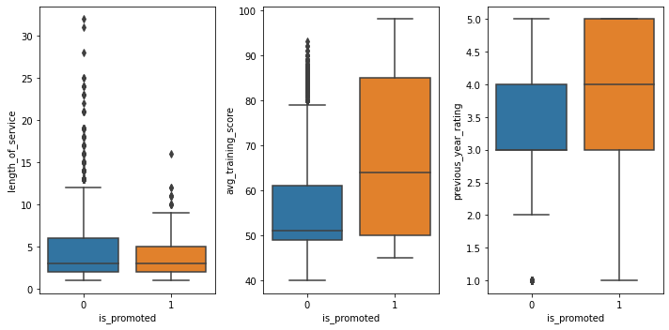
V. Exploratory Data Analysis- Python -I
a) Pie Chart displaying the distribution
of is_promoted
b) Chart showing is_promoted Count
Box Plot with relationship between is_promoted to other variables

Slide 8
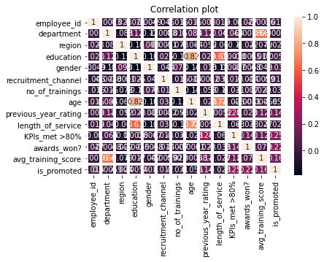
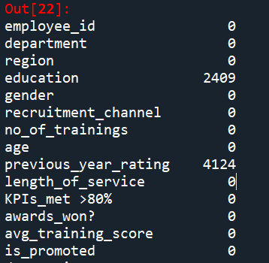
V. Exploratory Data Analysis- Python -II
Co-relation Heatmap
Missing Values in Data by Column

Slide 9
VI. Model Development and Validations
Based on the Problem statement and Train Data provided following were the Dependent and Independent Variables identified.
Target/Dependent Variable : is_promoted
Independent Variables : 'department', 'region', 'education', 'gender', 'recruitment_channel', 'no_of_trainings', 'age', 'previous_year_rating', 'length_of_service', 'KPIs_met >80%', 'awards_won?', 'avg_training_score'
Following Models have been developed to Predict the Target Variables and the Accuracy for each model is stated
in the table below :
Model Type | Accuracy
Logistic Regression | 89.5%
Decision Tree | 92.1%
Random Forest | 93.4%
Code File
Click here

Slide 10
VI. Model Development and Validations
Observations :
☒ Logistic Regression
Accuracy of Model is lowest among 3 methods . Hence discarded the Model.
☒ Decision Tree
Accuracy of Model is higher than logistics regression and comparable to Random Forest.
Low Bias based on Model created from Training Data
High Variance on Test Data
☑ Random Forest :
Highest Accuracy
Low Variance
Change in Test Data results in Low Variance of results.

Slide 11
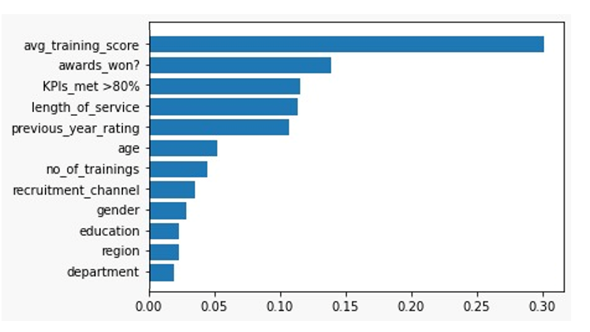
VI. Model Development and Validations
Observations :
Feature Importance –Random Forest

Slide 12
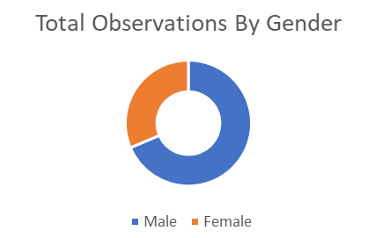
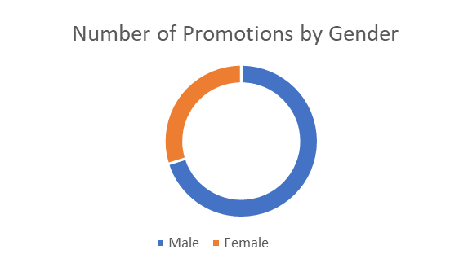
VII. Dashboarding
Based on the Model Output and predicted values for the predict csv files following are the observations:
Total Observations
1306
Number of Employees to be Promoted
123 – 124
% of Employees Promoted
9.4%
Population Ratio
Male : Female
7:3
Promotion Ratio
Male : Female
7:3

Slide 13
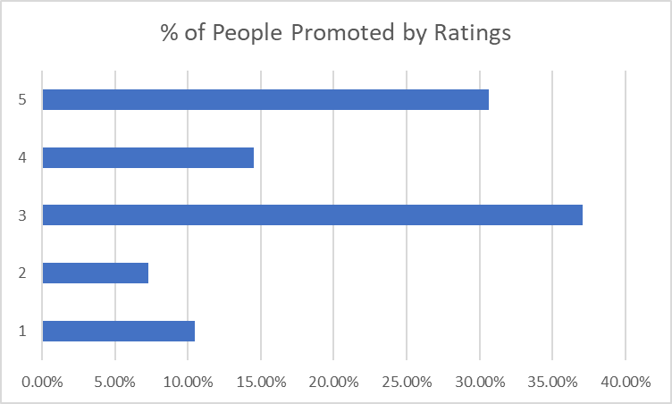
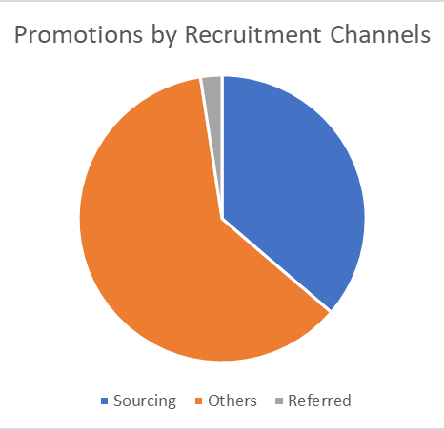
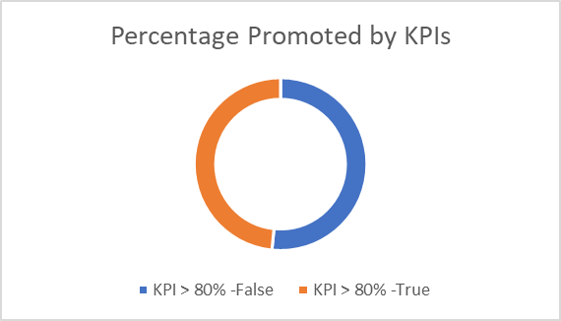
VII. Dashboarding
Based on the Model Output and predicted values for the predict csv files following are the observations:
Total Observations
1306
Number of Employees to be Promoted
123 – 124
% of Employees Promoted
9.4%

Slide 14
VIII. Businesss Recommendations and Potential Business Impact
Observations and Recommendations
Although there is a disparity in Gender Ratio (69% Males and 31% Females ) , the Predicted promotion is inline with the Gender Ratio . Out of the total predicted promotions (124) out of the 1306 observations, the Promotion is predicting the same ratio(70% males to be promoted, 30% females to be promoted)
Another Key observation in the train data and the test Data is that employees are getting promoted despite not meeting KPIs.
In the train Data Close to 30% of employees promoted have not met their KPIs
In the Predict Data as well there are close to 50% of the employees to be promoted have not met their KPIs
Employees with Consistent Performance are getting the most promotions . Employee with Ratings 3 and above from previous year are predicted to account for 83% of the total promotions
Based on Train Data and Predicted Test results , indications are that the Referred candidates are getting least promotions.
Better Categorization of Recruitment channel Data is needed as majority promoted are from the Channel “Others”. Need to understand the source of good talent.
Need to look at the referral program/interview Process to understand the quality of referrals coming into organisation. Possible remediation can be to restrict referrals to ex-colleagues or Fellow classmates.

Slide 15
X. Appendix
Reference:
1 >> https://scikit-learn.org/stable/modules/impute.html
2 >> Decision Tree Regression — scikit-learn 1.0.2 documentation
3 >> Model-based and sequential feature selection — scikit-learn 1.0.2 documentation
4 >> sklearn.model_selection.train_test_split — scikit-learn 1.0.2 documentation

Slide 16
Thank You !

